Slide 1
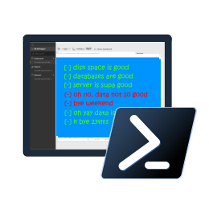

How we made Configurable Pester Tests For SQL Server
Rob Sewell @sqldbawithbeard https://sqldbawithAbeard.com

Slide 2
Speaker Questionnaire
Name : Rob
Occupation : DBA, Automator, Do-er, Trainer
Interests : PowerShell, Automation And SQL (PaaS geddit?)
Interesting Fact : Beard. (Still) Plays Cricket, Flies Drone
Speaker : SQL Saturdays, SQL Relay, PowerShell Events
Community : SQL South West , SQL Sat Exeter , PowerShell VG, PowerShell Conference EU Organiser, dbareports, dbatools, dbachecks, MVP

Slide 3
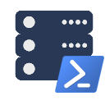





Contact Me
Quick Poll
@sqldbawithbeard
robsewellsqldba
sqldbawithAbeard.com
mrrobsewell@outlook.com
RobSewell.info

Slide 4

Background

Slide 5
dbatools
Community module founded by Chrissy
Over 100 contributors
5 billion commands to work with SQL Server (no point putting an actual number in here it will change!!)
Many commands to get information or check best practices

Slide 6
dbatools
Rob needed to validate estates at work
Wrote Pester tests using dbatools
More than a year discussing wondering the best way to enable configuration

Slide 7
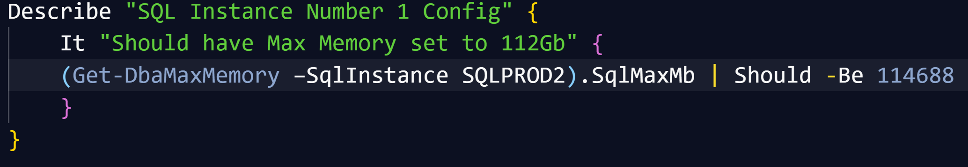
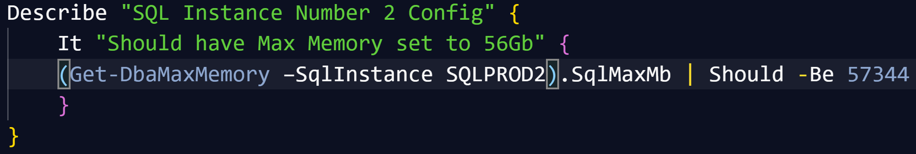
Pester
Writing Pester Tests for one SQL instance is easy once you “get” Pester
Writing slightly different Pester Tests for slightly different instances is copy and paste

Slide 8
Pester
Writing slightly different Pester Tests for slightly different instances is copy and paste
It is possible to parameterize Pester tests (but not so easy to say!)

Slide 9
Challenges & Goals

Slide 10
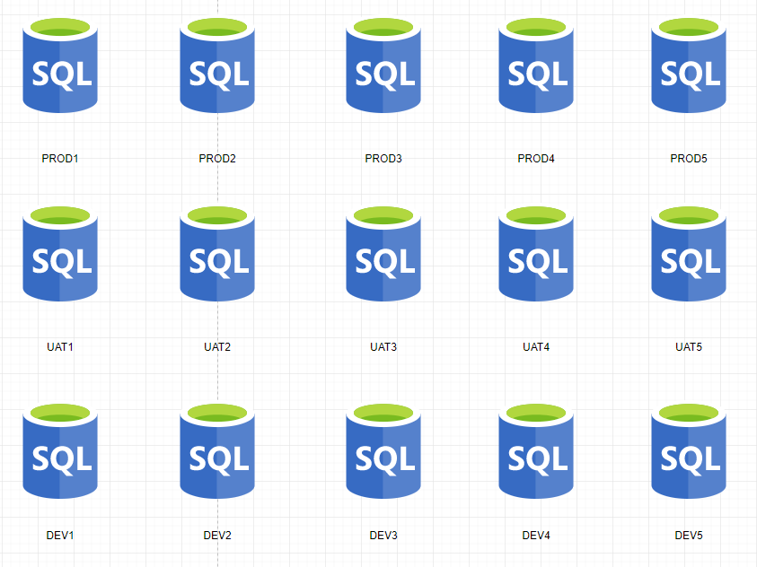
Consider A SQL Environment

Slide 11
Consider A SQL Environment
PRODUCTION
No SA account
Backup Compression
FULL Recovery
Secure Backup Location
Agent Alerts
Production Agent Jobs
Only Certain Production AD Groups allowed
And much more

Slide 12
Consider A SQL Environment
TEST
Different Backup Strategy
Test Agent Jobs
Needs the Testers AD Groups
And much more

Slide 13
Consider A SQL Environment
Development
Simple Recovery
No Agent Jobs
Definitely no Production AD Information
SA Account
And much more

Slide 14
Consider A SQL Environment
Widget One
Global view of one ‘widgets’ environments might be needed for
Project Managers
Team Leaders
Release Managers
Agile Teams

Slide 15
Consider A SQL Environment
Special Snowflakes
For those ‘special’ SQL Servers that don’t fit in the usual boxes
I.E. SharePoint

Slide 16
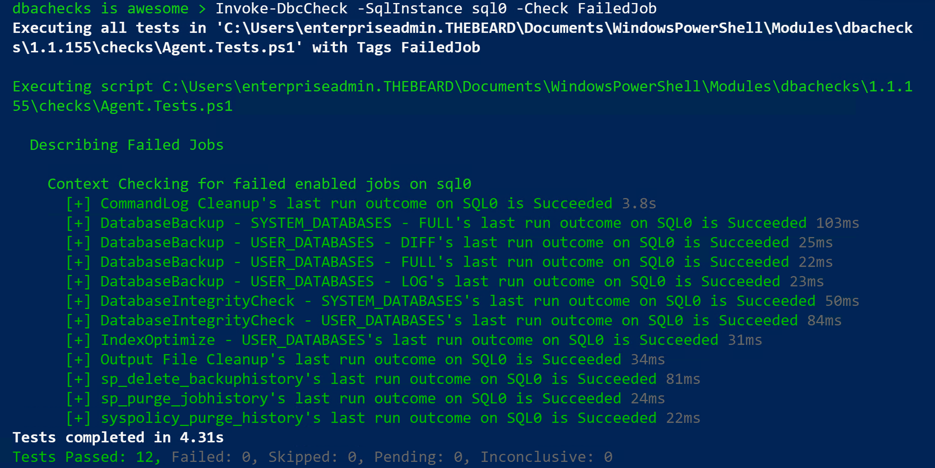
Challenge - Output
DBAs may need output instantly

Slide 17
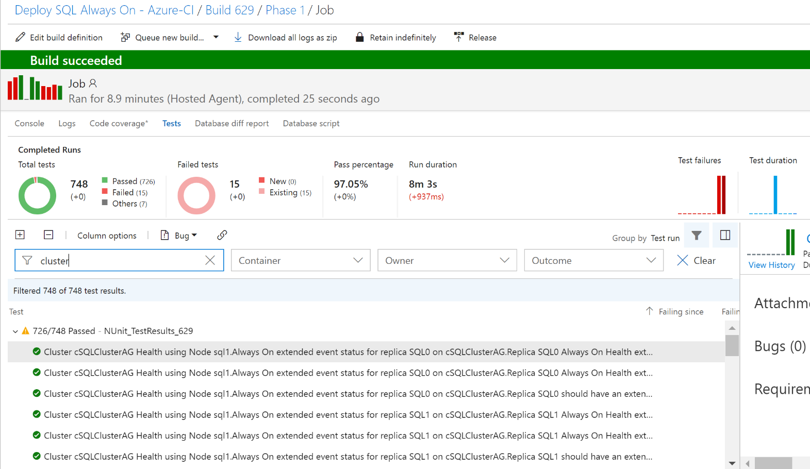
Challenge - Output
DBAs may want to automate and integrate with other solutions (DevOps, Daily Checks, Incident Response, Maintenance Windows)

Slide 18
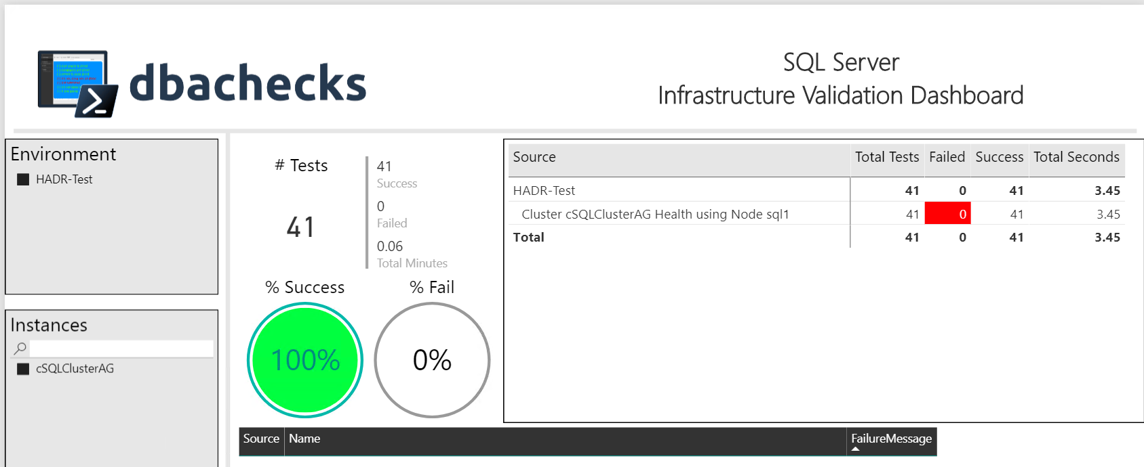
Challenge - Output
Management want output they understand
– (and with pretty interactive pictures !)

Slide 19
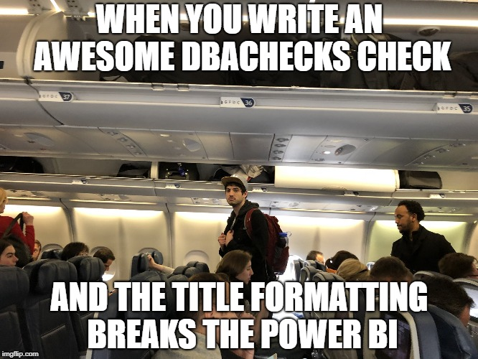
Challenge - Output
The Power Bi template requires a specific title configuration

Slide 20
Challenge – User Simplicity
End Users
Need simplicity to enable easy adoption
Need index for Checks
Need index for Configuration
Simplified output options
File system access to work across many differing user environments and permissions

Slide 21

Solution

Slide 22
Installation is easy
PowerShell Gallery
Install-Module dbachecks
Install-Module dbachecks –Scope CurrentUser
* Automatically installs required modules

Slide 23
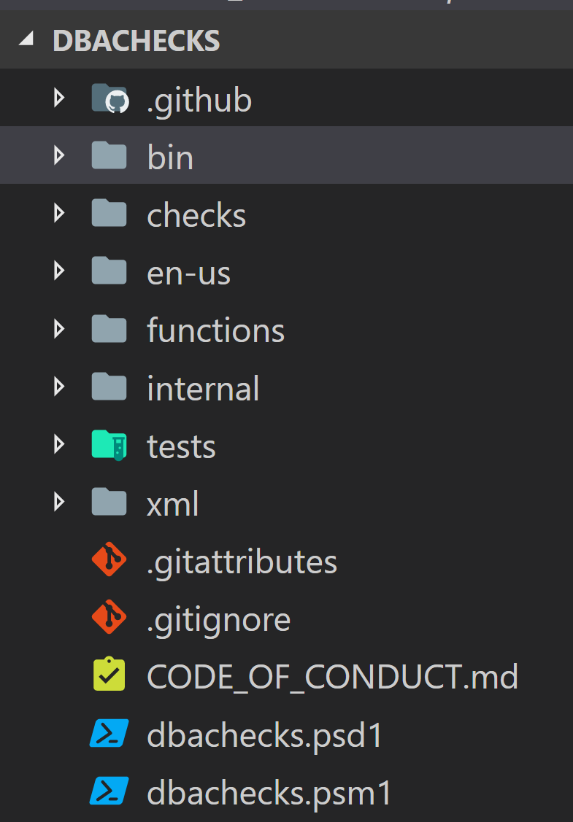
dbachecks
Notes:
Describe whats in the folders

Slide 24
Dbachecks – Configuration
Using PSFramework to create configuration items
Stored in registry
Set-PSFConfig -Module dbachecks -Name app.sqlinstance -Value $null -Initialize -Description "List of SQL Server instances"

Slide 25
Dbachecks – Configuration
Enabling Users to set configuration
Set-DbcConfig -Name app.sqlinstance -Value sql2016, sql2017
Set-DbcConfig -Name app.sqlinstance -Value sqlcluster –Append

Slide 26
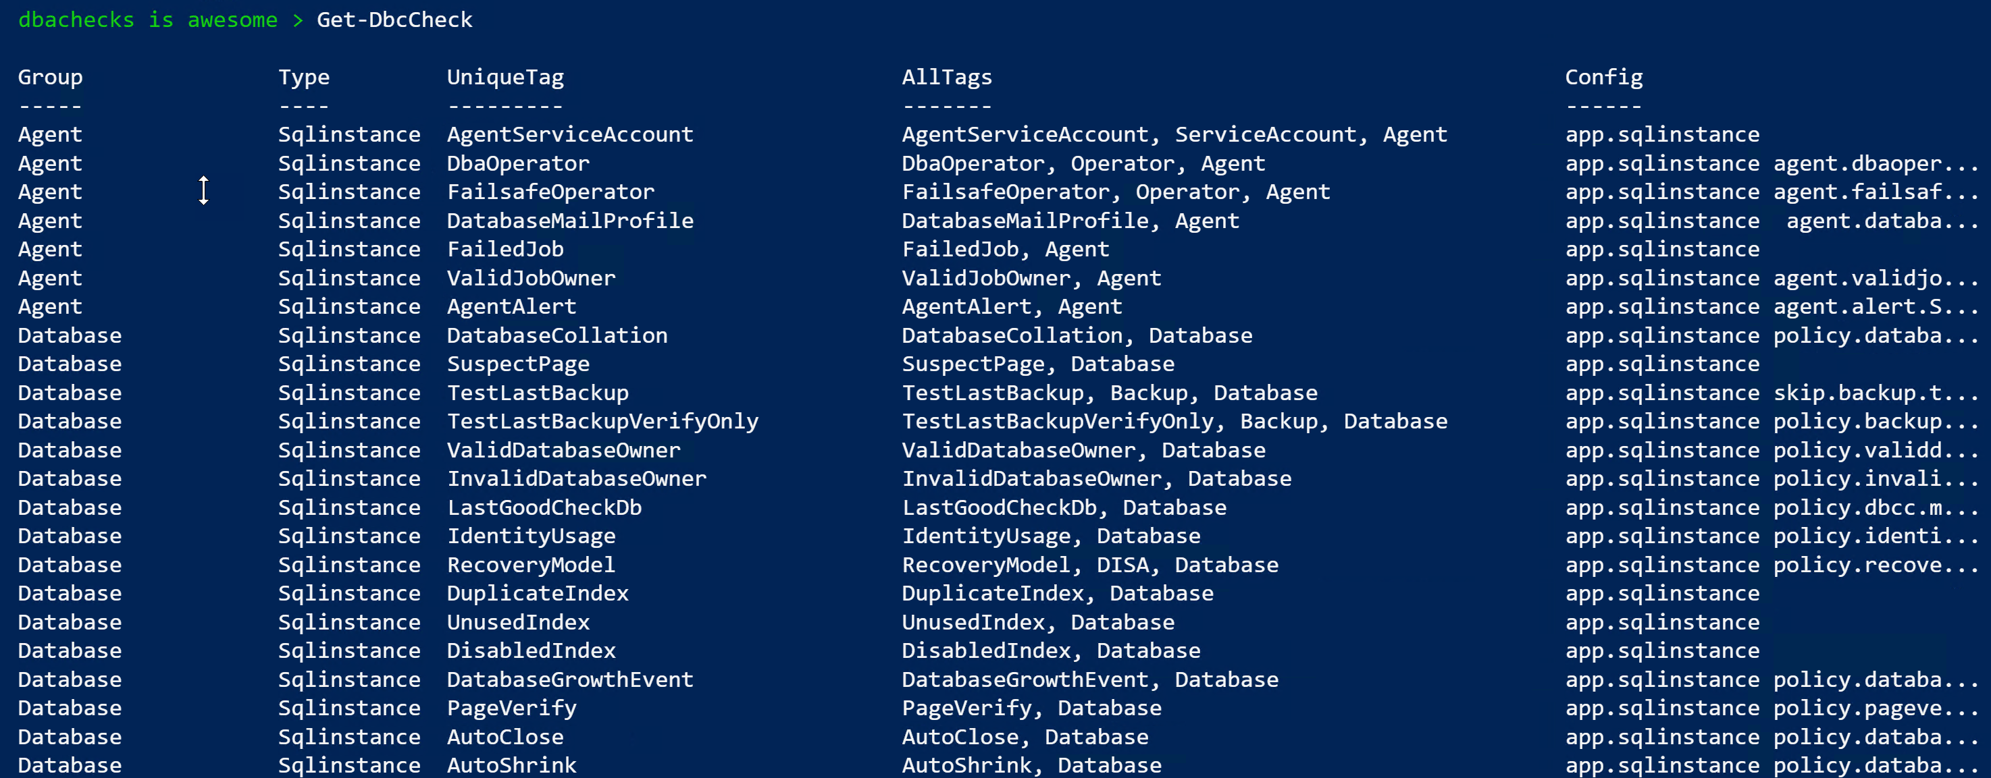
What Checks Are Available? Use Get-DbcCheck
PowerShell > Get-DbcCheck

Slide 27
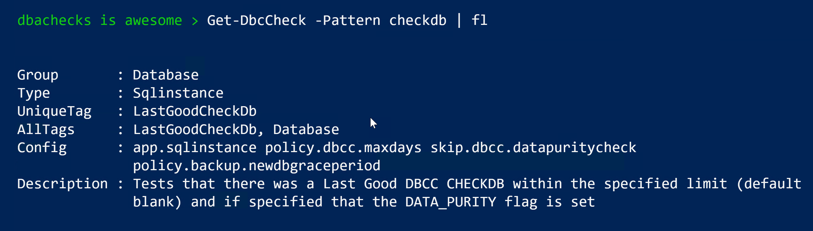
What Checks Are Available? Use Get-DbcCheck

Slide 28
What Checks Are Available? Use Get-DbcCheck

Slide 29
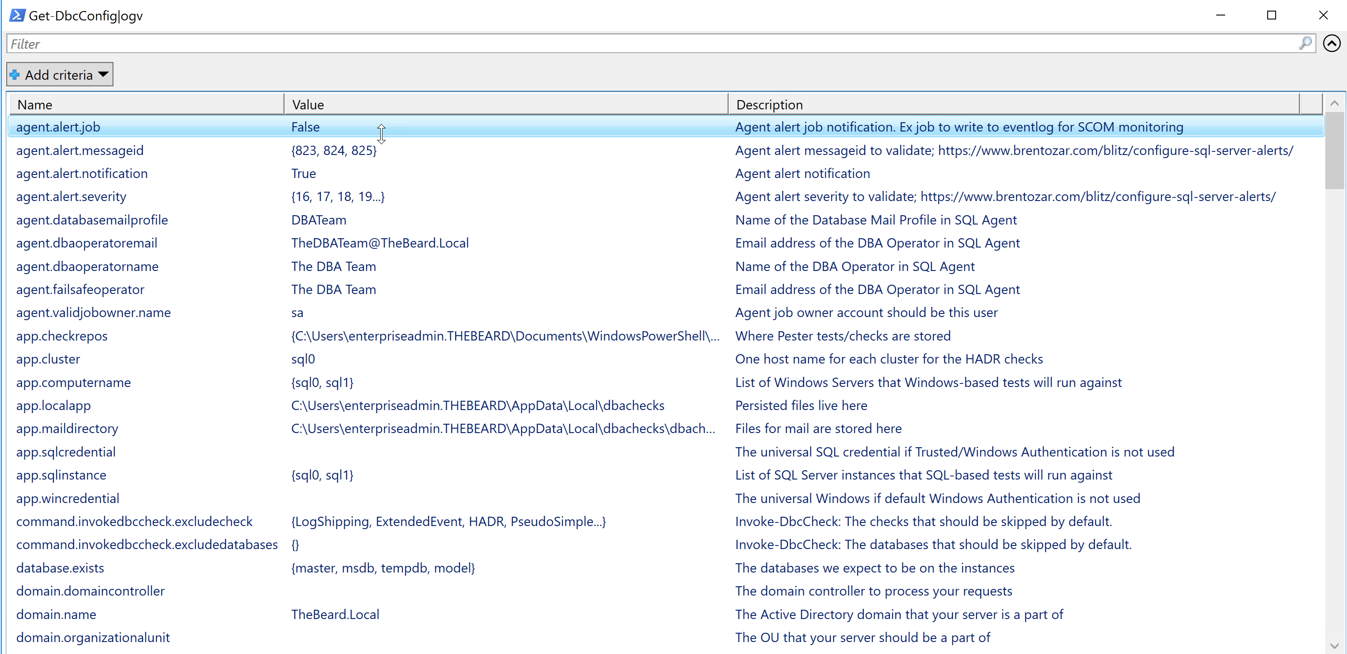
What Configs Are Available? Use Get-DbcConfig
PowerShell > Get-DbcConfig

Slide 30
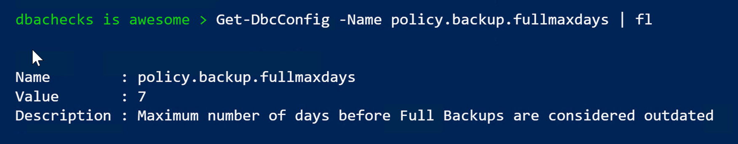
What Configs Are Available? Use Get-DbcConfig

Slide 31
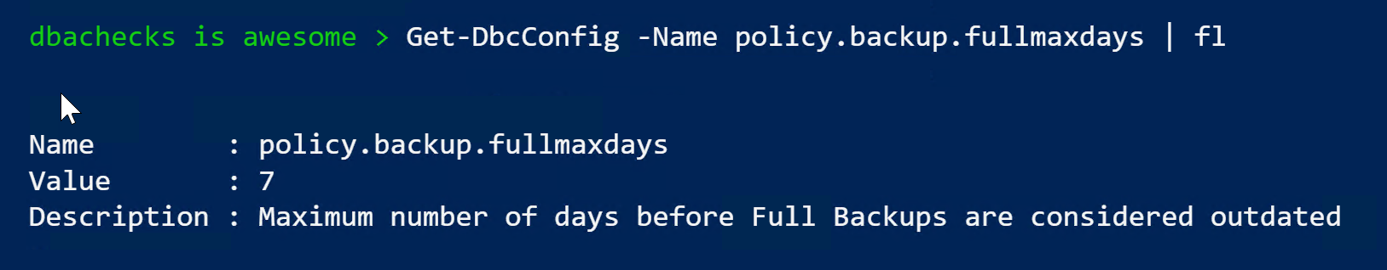
What Configs Are Available? Use Get-DbcConfig

Slide 32
How Do I Run A Check?
PowerShell > Invoke-DbcCheck –SqlInstance ROB-XPS –Check FailedJob

Slide 33
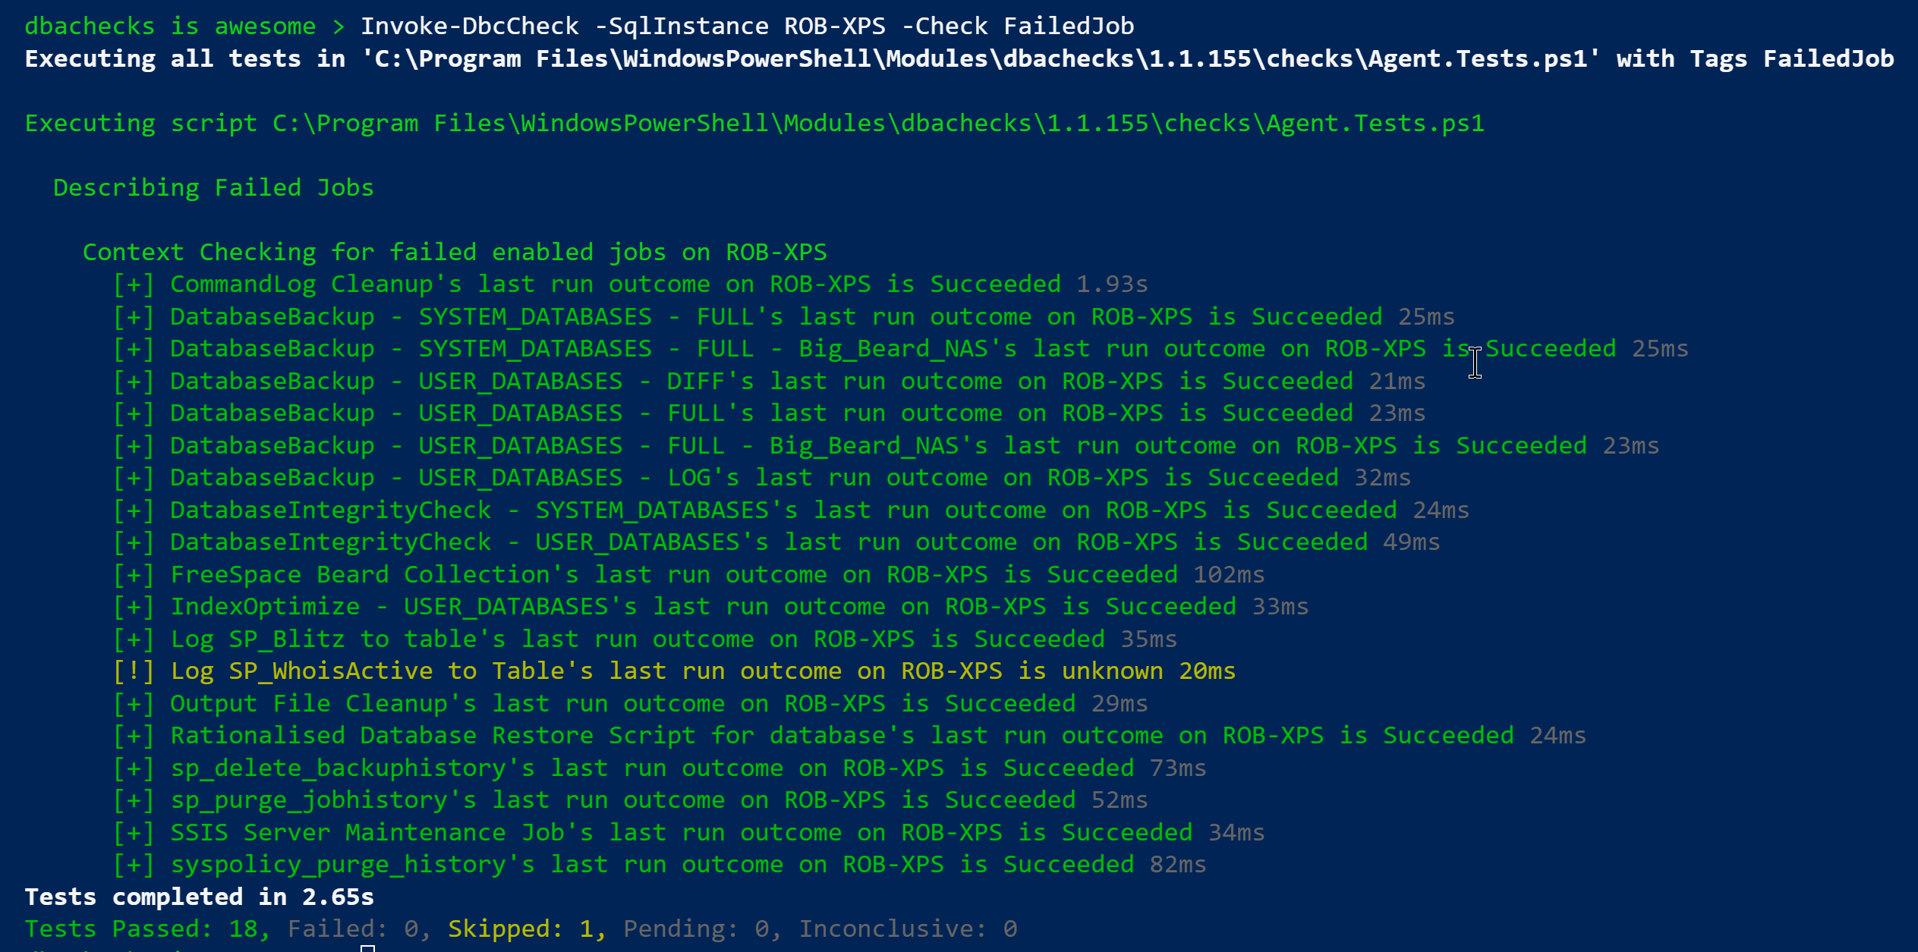
Invoke-DbcCheck – Run A Check

Slide 34
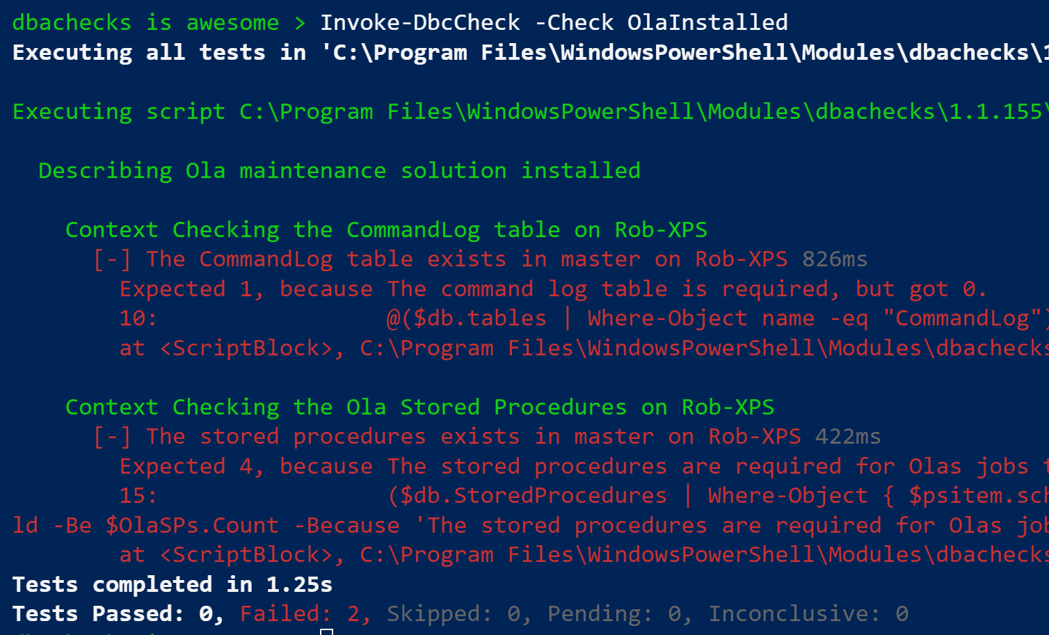
Configurations?
> # Set the instances to check
> Set-DbcConfig -Name app.sqlinstance Rob-XPS
> Invoke-DbcCheck -Check OlaInstalled

Slide 35
Configurations?
I don’t have Ola installed in the default database (master)
> Set-DbcConfig -Name policy.ola.database -Value DBA-Admin
> Invoke-DbcCheck -Check OlaInstalled

Slide 36
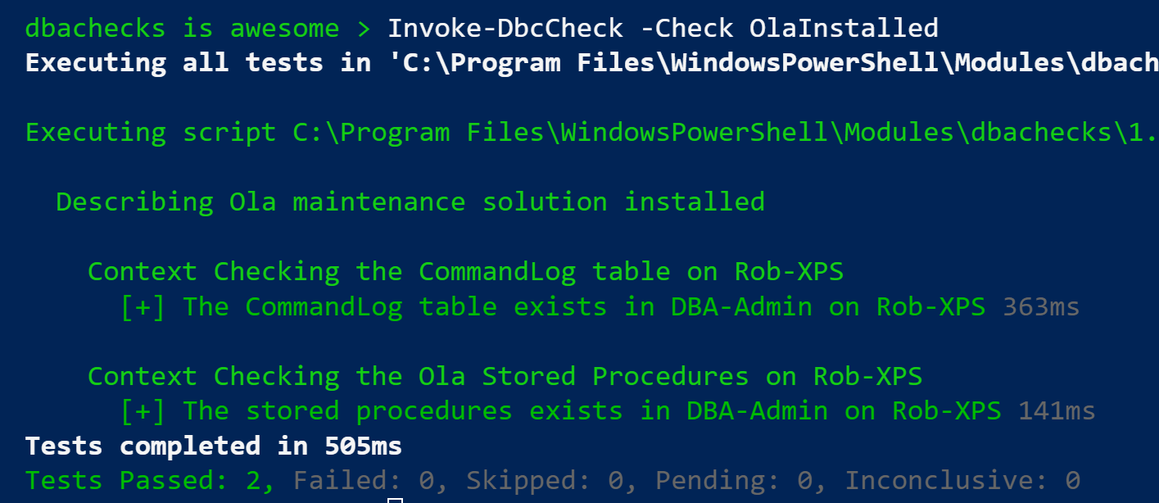
Configurations?
I don’t have Ola installed in the default database (master)
> Set-DbcConfig -Name policy.ola.database -Value DBA-Admin
> Invoke-DbcCheck -Check OlaInstalled

Slide 37
Configurations?

Slide 38
Export-DbcConfig/Import-DbcConfig
Export-DbcConfig –Path C:\Users\Beard\git\PesterConfigs\Application1_PROD.json
Export-DbcConfig -Path C:\Users\Hair\git\PesterConfigs\Client1_System2_Quick.json
Import-DbcConfig -Path Git:\PesterConfigs\Application1_PROD.json
Invoke-DbcCheck
Import-DbcConfig -Path Git:\PesterConfigs\Client1_System2_Quick.json
Invoke-DbcCheck

Slide 39
Start-DbcPowerBi
Import-DbcConfig –path Git:\PesterConfigs\App1_Dev.json
Invoke-DbcCheck -Show Summary -PassThru | Update-DbcPowerBiDataSource –Environment Development
Import-DbcConfig –path Git:\PesterConfigs\App1_Test.json
Invoke-DbcCheck -Show Summary -PassThru | Update-DbcPowerBiDataSource –Environment Test
Import-DbcConfig –path Git:\PesterConfigs\App1_PROD.json
Invoke-DbcCheck -Show Summary -PassThru | Update-DbcPowerBiDataSource –Environment Production
Start-DbcPowerbi

Slide 40
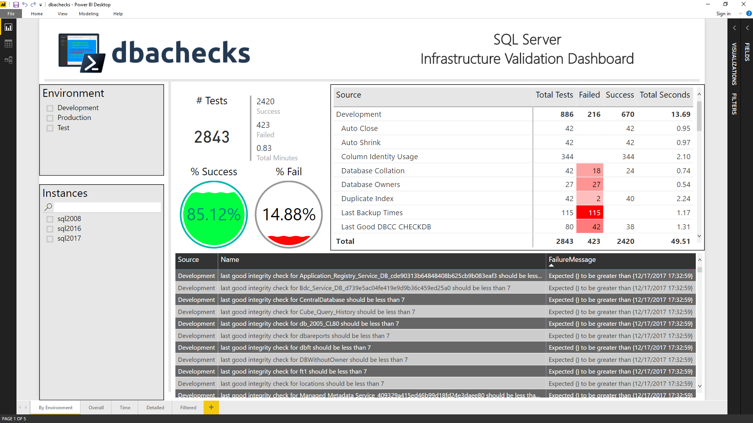
Start-DbcPowerBi

Slide 41
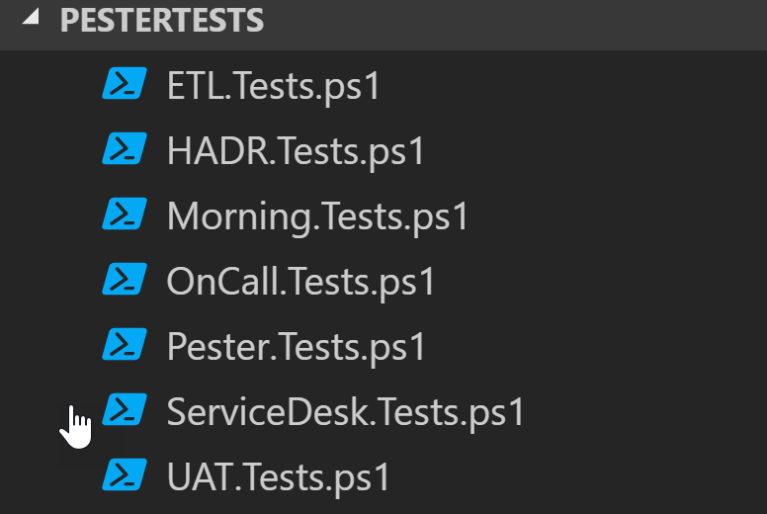
Got your own Checks?
Set-DbcConfig –Name app.checkrepos –Value ‘Path To PesterTests’

Slide 42

Hey Beardy !
MUST BE TIME FOR A DEMO

Slide 43
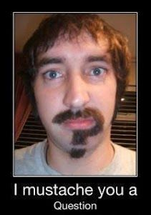
Questions?
?
?
?
?
?
?
?
?
?
?
?
?
?
?
?
?
Rob Sewell @sqldbawithbeard https://sqldbawithAbeard.com

Slide 44

Just like Jimi Hendrix …
We love to get feedback
Please complete the
session feedback forms

Slide 45
Contact Me
Quick Poll
@sqldbawithbeard
robsewellsqldba
sqldbawithAbeard.com
mrrobsewell@outlook.com
RobSewell.info

Slide 46
What is Pester?
Test Runner for PowerShell
A Unit Testing Framework
An Infrastructure Testing Framework
https://github.com/pester
Notes:
https://www.youtube.com/watch?v=lNCR5yLSwi0 -- Test your Powershell with Pester and PSScriptAnalyzer
“Untested Code is Broken Code”
Infrastructure Testing with Pester - https://www.youtube.com/watch?v=zSEK74_fsLw
Pester is a unit-testing framework for PowerShell, and perhaps the first open-source software product that ships with Windows itself!
Author Adam Bertram will walk you through the Pester philosophy, syntax, and numerous real-world examples in this "Agile-published" book.
The Pester Book
https://leanpub.com/creatinghtmlreportsinwindowspowershell
https://leanpub.com/powershell-scripting-toolmaking
https://leanpub.com/pesterbook

